Slide 1
Work Progress
By: Abdur Rehman

Slide 2
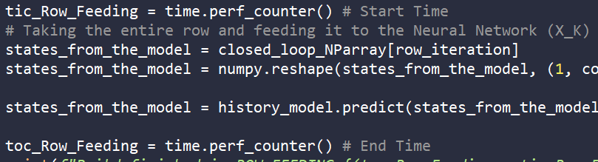
Closed Loop Simulation
Total Time Elapsed: 112 minutes 21 seconds
Used Tic and Tac functionalities to measure the time period between specific regions of the code
Most of the time period consumed in the Closed Loop Simulations was during the model.predict stage: history_model.predict(states_from_the_model)
Average Time Spent on Model Prediction Iteration: 0.050 seconds
Column Iteration Time: 0.130 seconds
Row Iteration Time: 1 minute 4 seconds

Slide 3
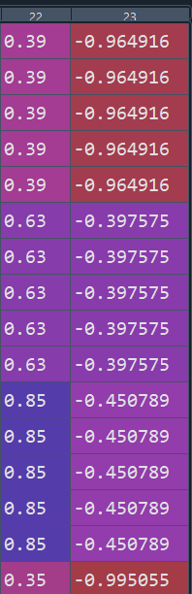
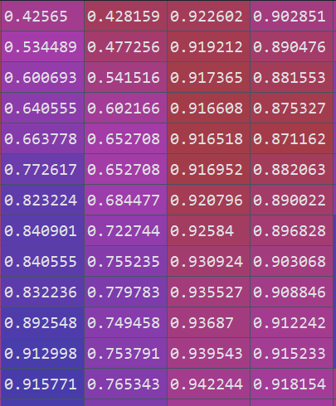
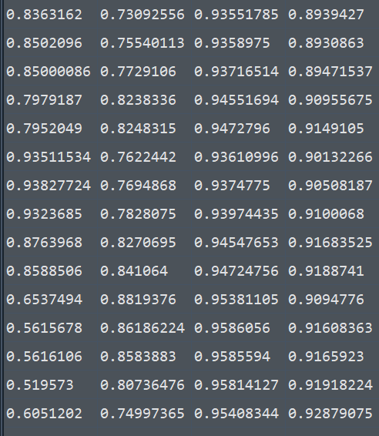
Graphs Generated and Model Discussion
Input on TRAINING Data for the first 100 data points: the temperature inside the reactor (TR) and the temperature of the cooling jacket (TK)
Input Simulated Output Data from NN

Slide 4
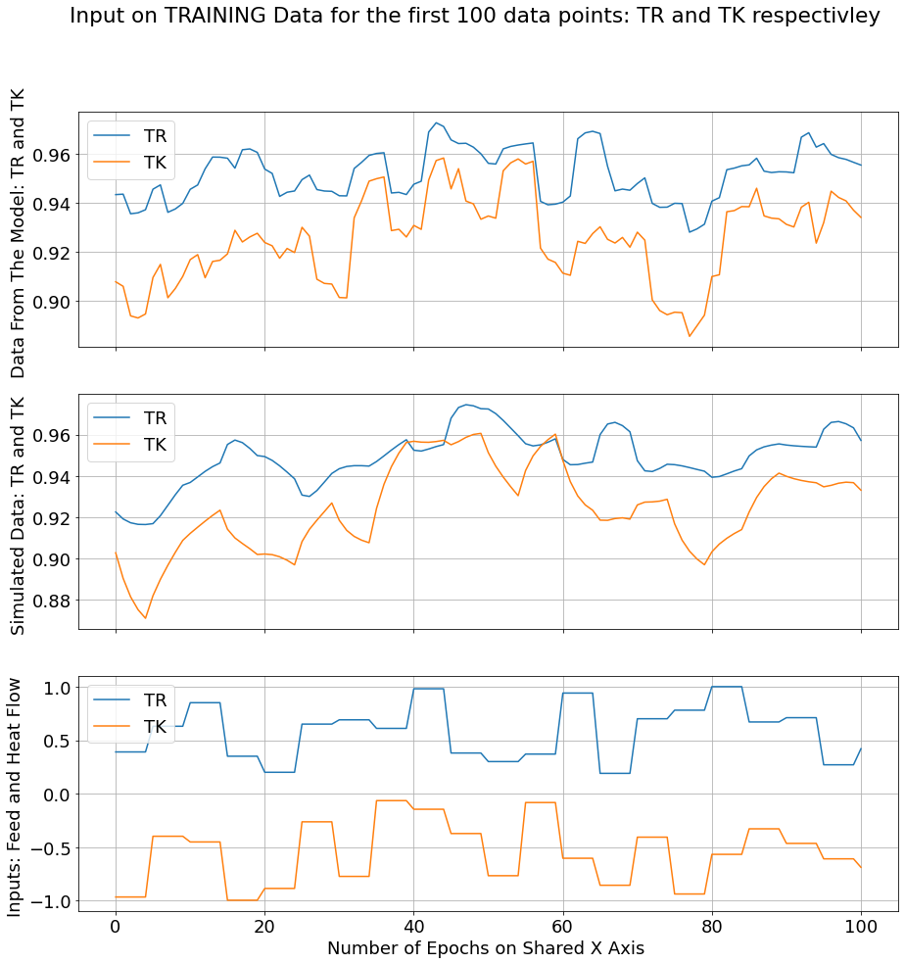

Slide 5
Graphs Generated and Model Discussion
Input on TRAINING Data for the first 100 data points: the Concentration of reactant A (CA) and the Concentration of reactant B (CB)
Input Simulated Output Data from NN

Slide 6
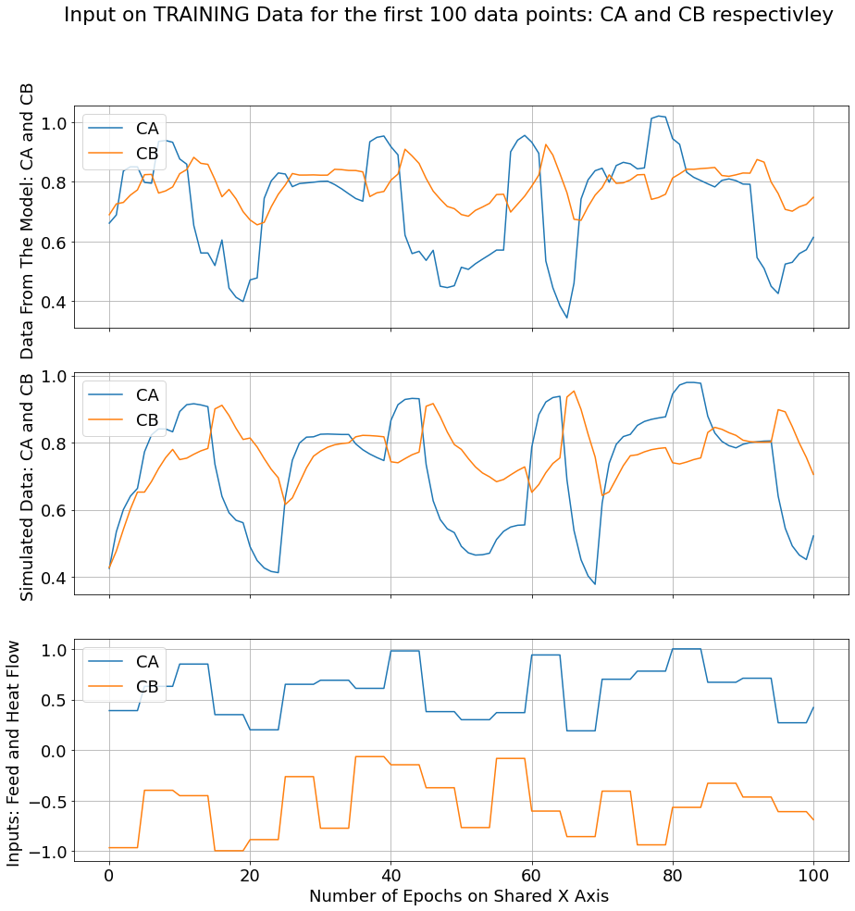

Slide 7
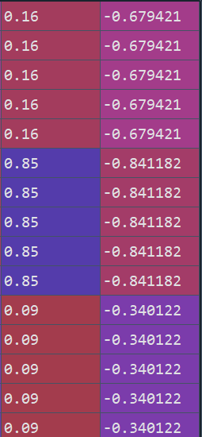
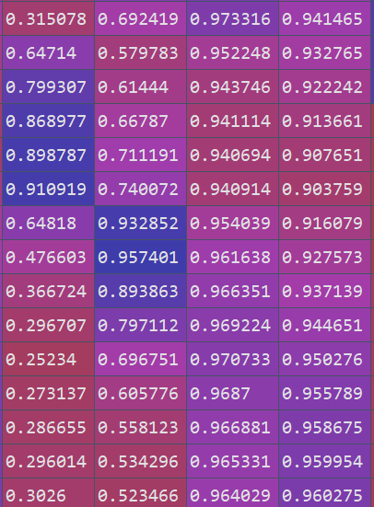
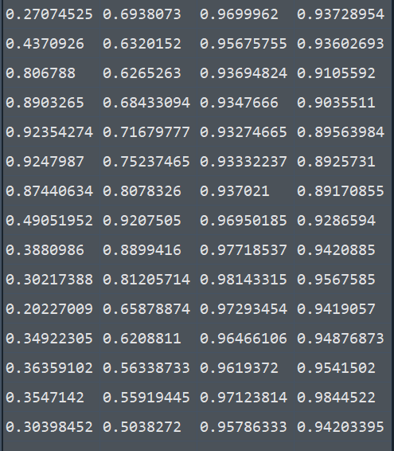
Graphs Generated and Model Discussion
Input on TESTING Data for the first 100 data points: the temperature inside the reactor (TR) and the temperature of the cooling jacket (TK)
Input Simulated Output Data from NN

Slide 8
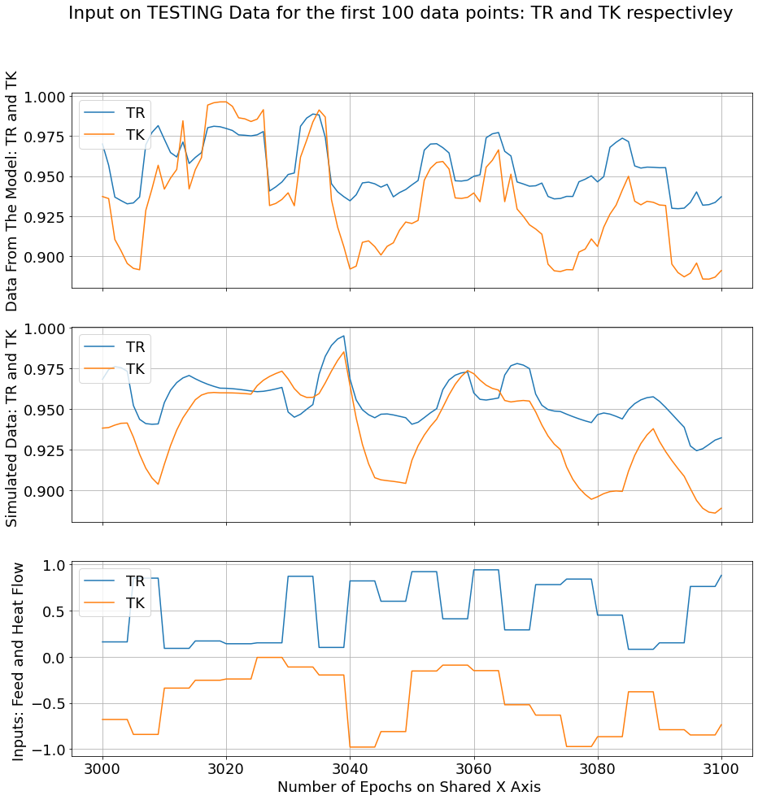

Slide 9
Graphs Generated and Model Discussion
Input on TESTING Data for the first 100 data points: the Concentration of reactant A (CA) and the Concentration of reactant B (CB)
Input Simulated Output Data from NN

Slide 10
